Slide 1
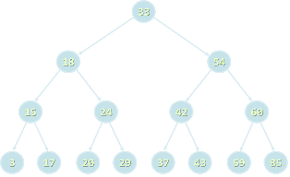
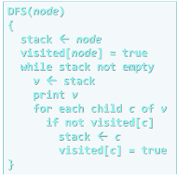
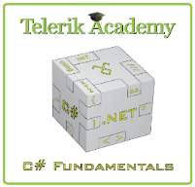

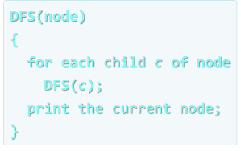
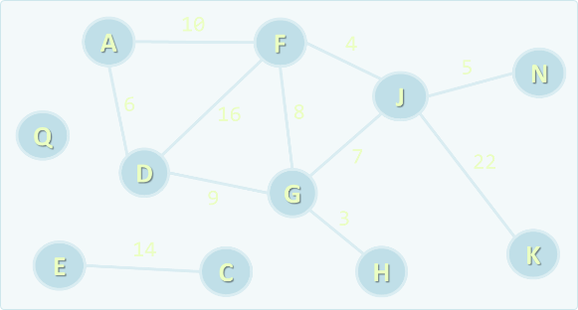
Data Structures and Algorithms
Course Program, Evaluation, Exams, Resources
Data structures and algorithms
Telerik Software Academy
http://academy.telerik.com

Slide 2

Table of Contents
What's Coming Next in the Academy?
The Data Structures and Algorithms Program
The Trainers Team
Exams and Evaluation
The Practical Exam
Recommended Books
Resources for the Course

Slide 3

Data Structures & Algorithms
The Next Module in the Software Academy (The Programming Track)

Slide 4

What's Coming Next?
Data Structures and Algorithms (DS&A)
Continuation of High-Quality Code course
Data structures (lists, trees, hash-tables, graphs), complexity, algorithms (recursion, combinatorics, dynamic programming, graphs)
Lectures 3 times a week
The course exam?
Practical exam (@ BGCoder)

Slide 5
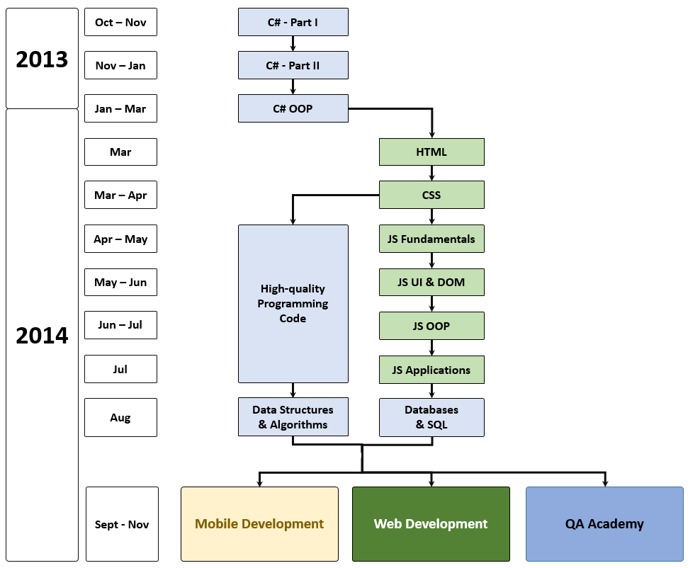
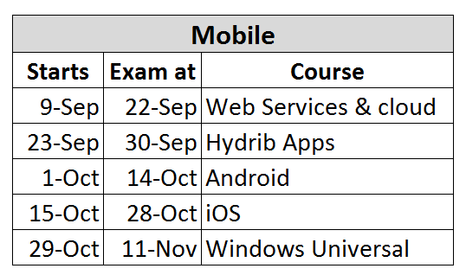
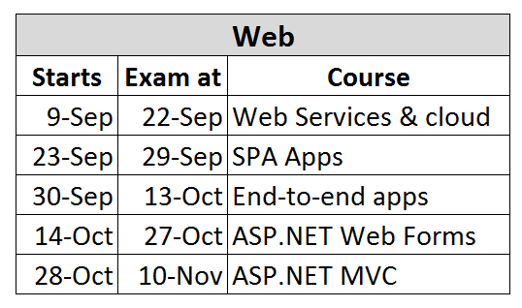
What's Coming Next?

Slide 6


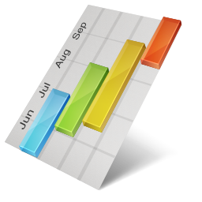
Data Structures and Algorithms Course Program
What Will We Cover in the Course?

Slide 7
The Course Program
Course Overview. Overview of Data Structures, ADT and Algorithms. Algorithm Complexity.
Linear Data Structures: List, Queue, Stack Trees, Tree-Like Structures, Balanced Search Trees. Tree Traversals: BFS and DFS
Dictionaries, Hash Tables and Sets
Advanced Data Structures. Wintellect Power Collections. Bag, Multi-Dictionary, Priority Queue. Data Structure Efficiency.
Sorting and Searching Algorithms

Slide 8

The Course Program (2)
Recursion
Combinatorial Algorithms. Generating Variations, Permutations, Combinations
Dynamic Programming. Divide-and-Conquer. Classical Dynamic Programming Problems
Graphs, Representation and Basic Graph Algorithms (Shortest Paths, Minimal Spanning Tree). Other Algorithms (Greedy, Geometry, Randomized)
Problem Solving Methodology.
Exam Preparation and Exam

Slide 9

The Trainers Team

Slide 10

Trainers Team
Nikolay Kostov
Team Lead, Senior Developer and Trainer @ Telerik Corp.
Student at Sofia University
Computer Science
IT and Informatics competitions contestant
Graduate from the second season of Telerik Software Academy
Email: nikolay.kostov [at] telerik.com
Blog: http://nikolay.it

Slide 11

Trainers Team (2)
Doncho Minkov
Senior Technical Trainer @ Telerik Software Academy
Student in Sofia University
Software Engineering
Contestant in the Informatics competitions
Graduate from the first season of Telerik Software Academy
Email: doncho.minkov [at] telerik.com
Blog: http://minkov.it

Slide 12

Trainers Team (3)
Ivaylo Kenov
Technical Trainer @ Telerik Software Academy
Graduate from the fourth season of Telerik Software Academy
Mathematical competitions contestant
E-mail: ivaylo.kenov [at] telerik.com
Champion in OOP and DSA
http://ivaylo.bgcoder.com

Slide 13

Trainers Team (4)
Evlogi Hristov
Technical Trainer @ Telerik Software Academy
Graduate from the fourth season of Telerik Software Academy
E-mail: evlogi.hristov [at] telerik.com

Slide 14



Evaluation
Data
Strucs
Thank God There Are Bonuses!
Algo-
rithms
Exams!

Slide 15

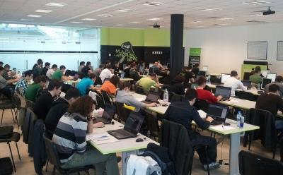
Data Structures & Algorithms – Evaluation
Evaluation components
Practical exam – 75%
Homework – 10%
Homework evaluation – 5%
Attendance in class – 10%
Bonuses
Forums activity – bonus up to 5%

Slide 16


Pass / Excellence / Fail Criteria
Criteria for pass / pass with excellence / fail
Pass with excellence
Very high exam results
or
High total results
Pass
Average total results
Fail
Low total results or low exam results

Slide 17
Homework Peer Reviews
Everyone will get feedback for their homework
Everyone will give feedback for few random homework submissions
Students submit homework anonymously
Please exclude your name from the submissions!
For each homework submitted
Students evaluate 3 random homeworks
From the same topic, after the deadline
Give written feedback, at least 200 characters
Low-quality feedback → report for punishment

Slide 18

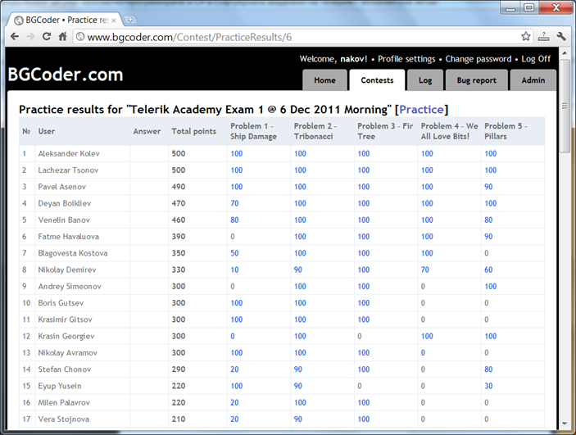

Practical Exam
5 practical problems for 8 hours
Real-time feedback @ BGCoder

Slide 19



Use the Same Email!
Please use the same email address in:
http://telerikacademy.com
http://bgcoder.com
http://forums.academy.telerik.com
Otherwise your score could be incorrectly calculated!

Slide 20

Recommended Books

Slide 21

The C# Textbook
The official textbook for the course
“Introduction to Programming with C#”, Nakov S. and his team, 2010
Freely downloadable from: www.introprogramming.info
The C# programming tracks follows the book
Data Structures → chapters 16-19
Algorithms → chapters 23-26 (partially)

Slide 22

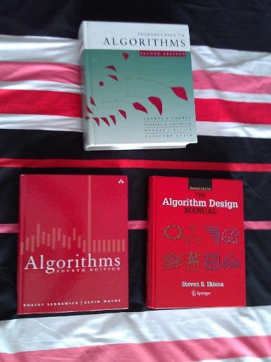
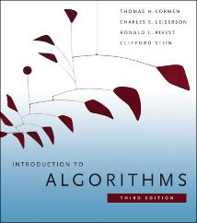
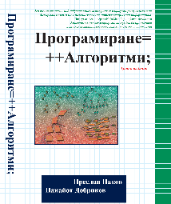
Recommended Books
Telerik Algo Academy
algoacademy.telerik.com
Introduction to Algorithms Cormen, Leiserson, Rivest, and Stein ISBN 9780262033848, goo.gl/cf3b5
Programming = ++Algorithms; Preslav Nakov, Panayot Dobrikov, ISBN 954-8905-06-X www.programirane.org
Animated structures and algorithms

Slide 23








Resources
What We Need in Addition to this Course Content?

Slide 24
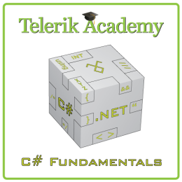
Course Web Site & Forums
Register for the "Telerik Academy Forums":
Discuss the course exercises with your colleagues
Find solutions for the exercises
Share source code / discuss ideas
The DS&A official web site:
forums.academy.telerik.com/csharp-programming/data-structures-algorithms
http://academy.telerik.com/student-courses/programming/data-structures-algorithms/

Slide 25
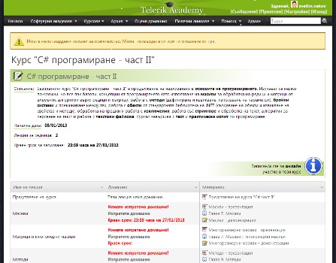
Telerik Integrated Learning System (TILS)
The Telerik Integrated Learning System (TILS)
www.telerikacademy.com
Important resource for all students
Homework submissions
Homework peer reviews
Presence cards with barcode
Reports about your results
telerikacademy.com/Courses/Courses/Details/186

Slide 26


Required Software
Software needed for this course:
Microsoft Windows (XP / Win7 / Win8)
Microsoft Visual Studio 2013 or Visual Studio Express 2013 (free version of VS 2013)
.NET Framework 4.5 (included in Visual Studio)
Visual Studio 2012 is also OK

Slide 27
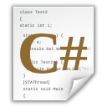
Data Structures and Algorithms
http://academy.telerik.com

Slide 28
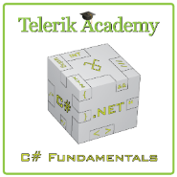



Free Trainings @ Telerik Academy
C# Programming @ Telerik Academy
csharpfundamentals.telerik.com
Telerik Software Academy
academy.telerik.com
Telerik Academy @ Facebook
facebook.com/TelerikAcademy
Telerik Software Academy Forums
forums.academy.telerik.com

